Slide 1


Optimization Odyssey:
Navigating the Maze of Neural Network Tuning

Slide 2
Revolutionizing Machine Learning: The Power of Artificial Neural Networks
Pattern and Speech recognition.
Natural Language Processing.
Handling High-Dimensional data and learning Hierarchical representations.
Development of Autonomous vehicles, Robotics.
Democratization of AI.

Slide 3

The Optimization Phenomenon
Problem Formulation
Iterative process
Solution evaluation
Solution refinement
Solution implementation

Slide 4



Convergence of Optimization and Artificial Biology: Exploring the Synergy of Efficiency and Adaptation
Where the human concept of trial and error and the artificial art of continuous learning collide
Trial, failure, and the will to try again
Continuous Learning

Slide 5
Optimization Frontier: Unlocking Algorithmic Brilliance
Gradient Descent (GD)
Stochastic Gradient Descent (SGD)
Mini-Batch Gradient Descent
Momentum
Nesterov Accelerated Gradient (NAG)
Levenberg-Marquardt
Quickprop
Rprop (Resilient Backpropagation)
Adagrad (Adaptive Gradient)
RMSProp (Root Mean Square Propagation)
Adam (Adaptive Moment Estimation)
AdaDelta (Adaptive Learning Rate)
Adamax
Limited-memory BFGS (L-BFGS)
Nadam (Nesterov-accelerated Adaptive Moment Estimation)
AMSGrad (Adaptive Moment Estimation with Stochastic Gradient Descent)
Adadelta
Natural Evolution Strategies (NES)
Evolution Strategies (ES)
Conjugate Gradient (CG)

Slide 6
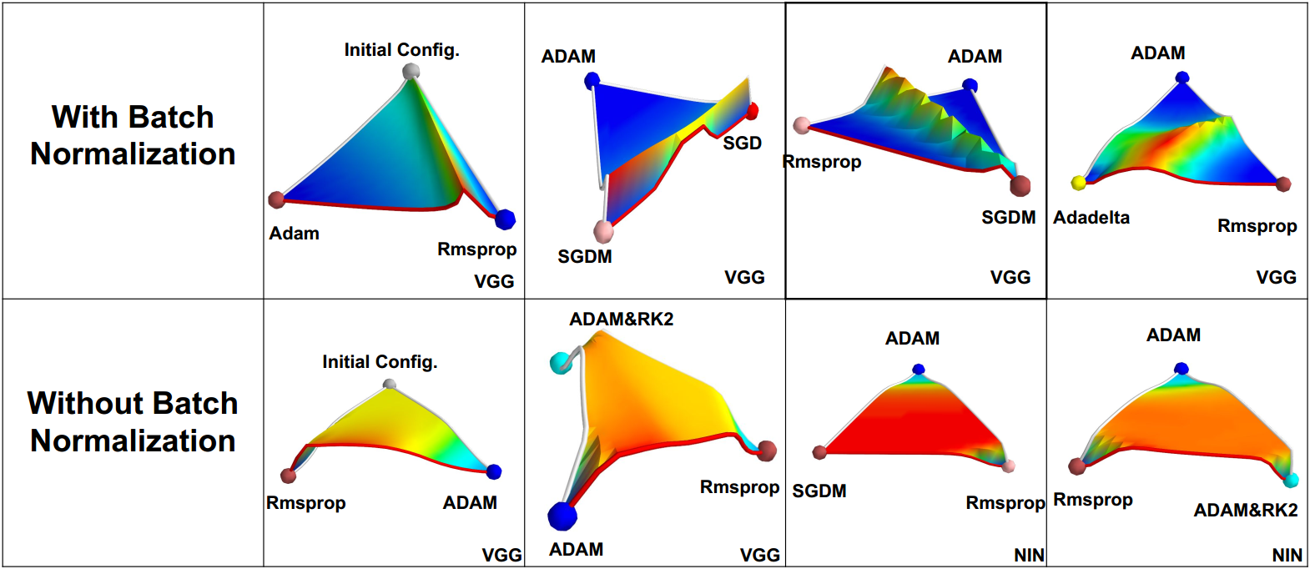
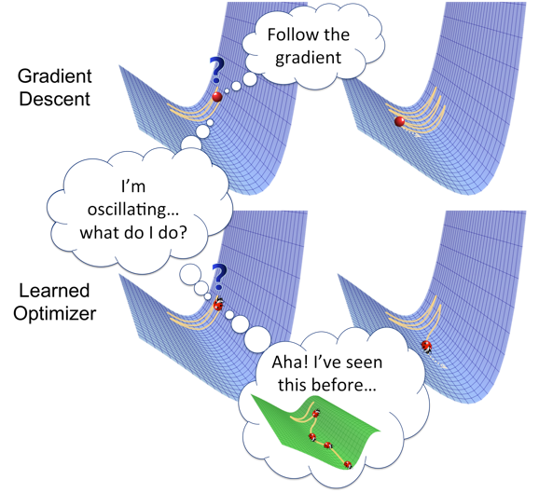

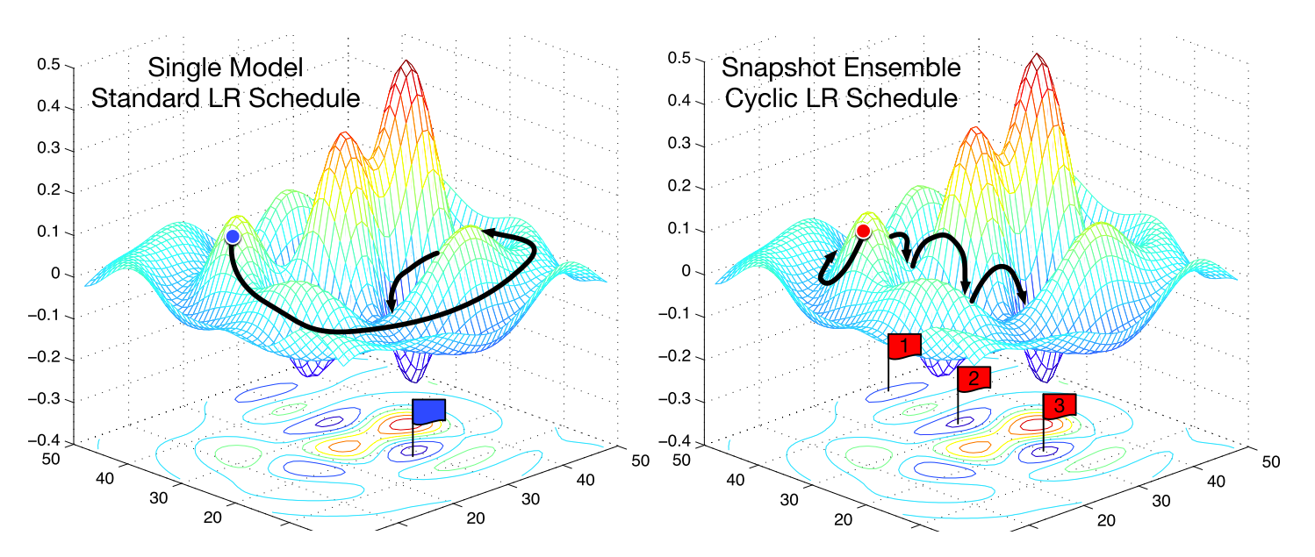
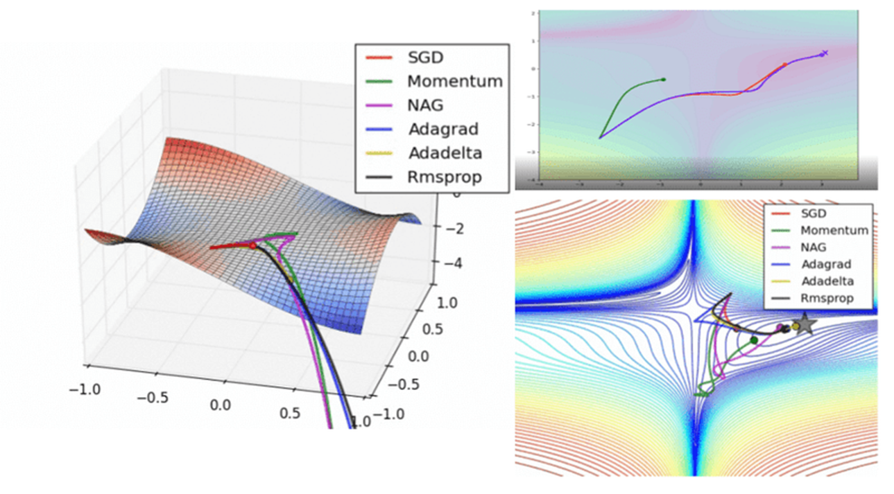

Slide 7
In Pursuit of Perfection: The Big 5
A Cut Above the Rest: Introducing the 5 Superior Optimizer Algorithms for Our Project
SGD (Stochastic Gradient Descent)
Adam (Adaptive Moment Estimation)
Adagrad (Adaptive Gradient Algorithm)
RMSProp (Root Mean Square Propagation)
Nadam (Nesterov-accelerated Adaptive Moment Estimation)

Slide 8
Some boring stuff
Breast Cancer Classification with different Optimization Algorithms
Which one of the big 5 is more optimal in terms of Accuracy and Loss Function?
Let us find out..

Slide 9
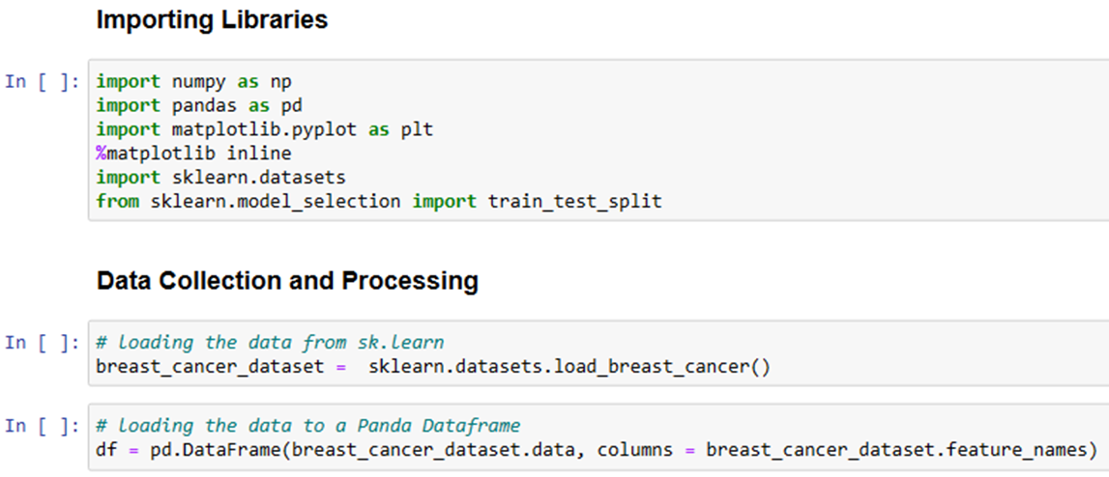
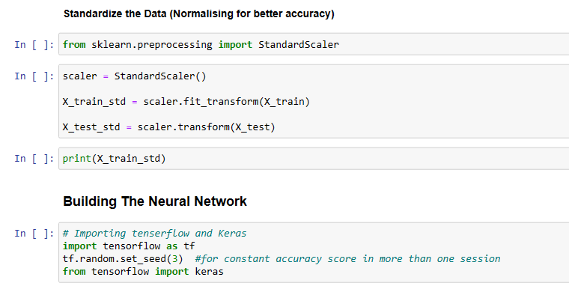

Slide 10
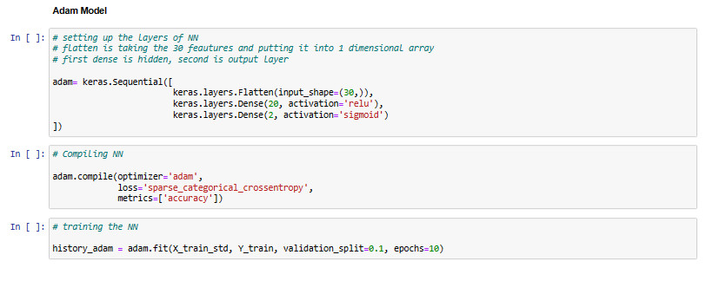
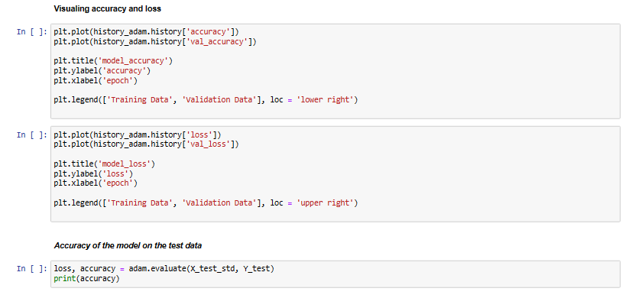

Slide 11
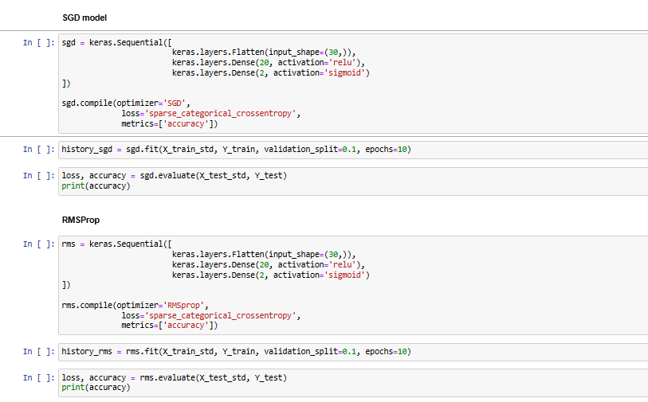

Slide 12
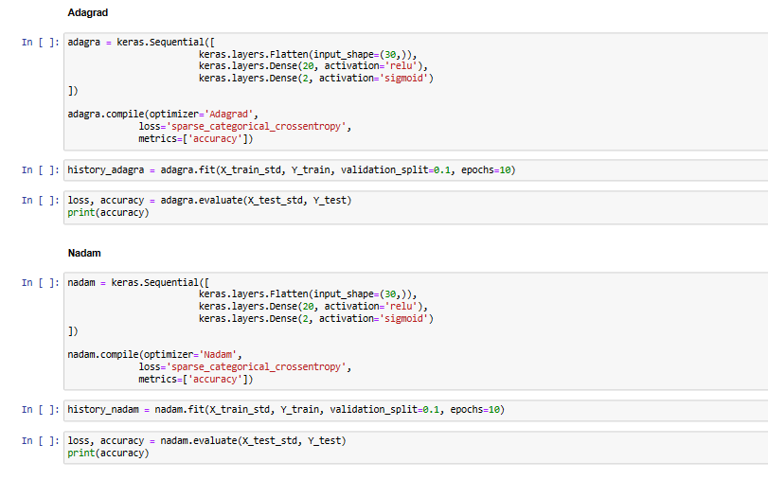

Slide 13
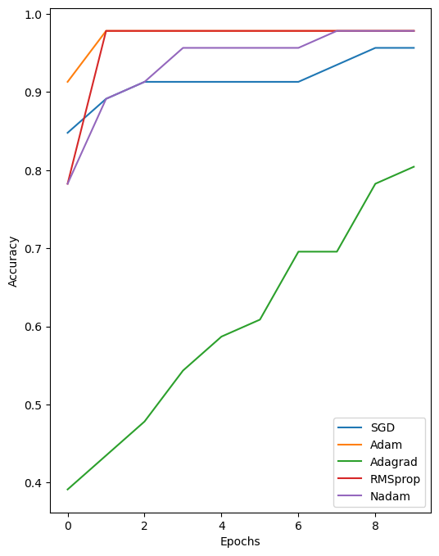
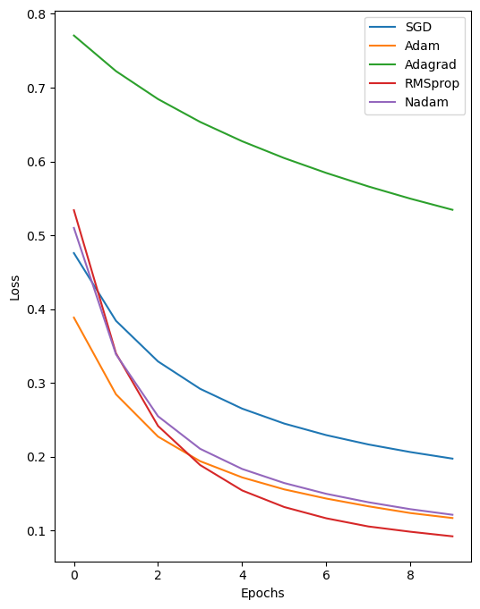
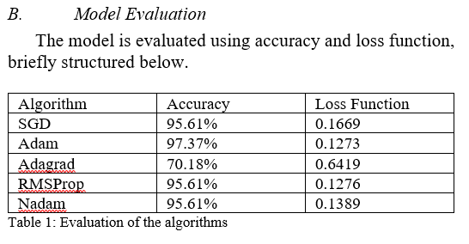
Findings
Behavior in Accuracy
Behavior in Loss Function

Slide 14
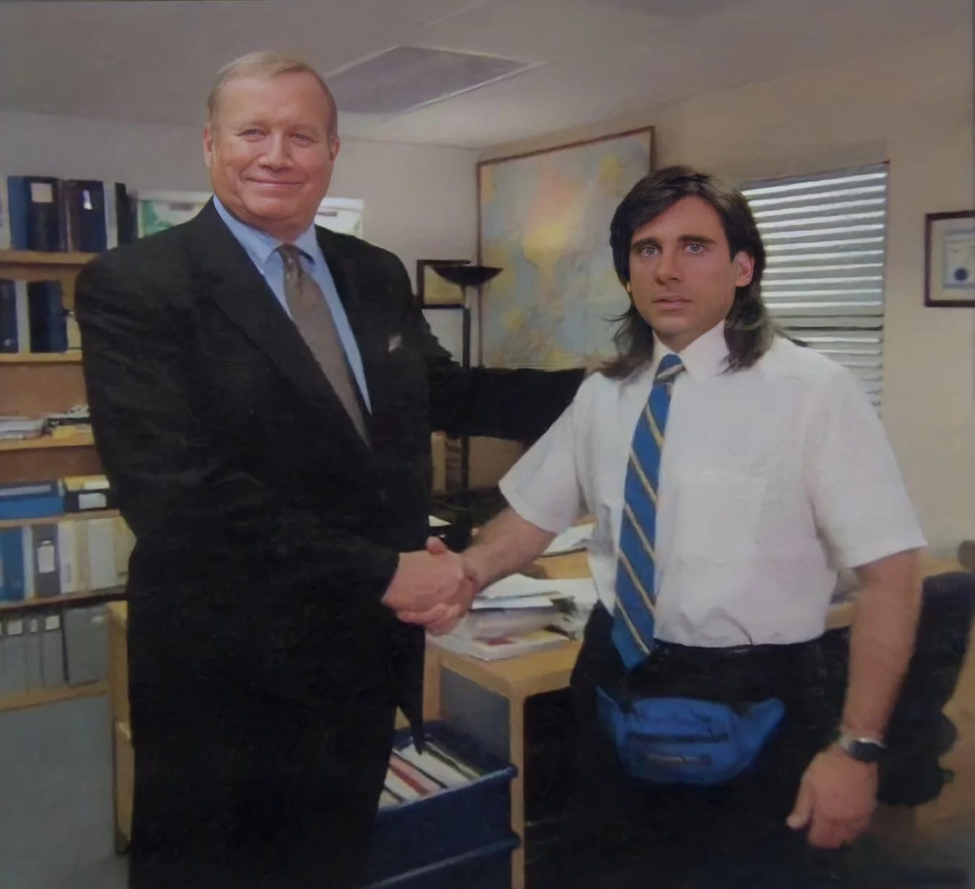
Adam takes the apple fruit
With the highest Accuracy of rate 97.37% and the lowest Loss Function of 0.1273, the Adam optimizer is clearly the most powerful optimizer in this study.

Slide 15
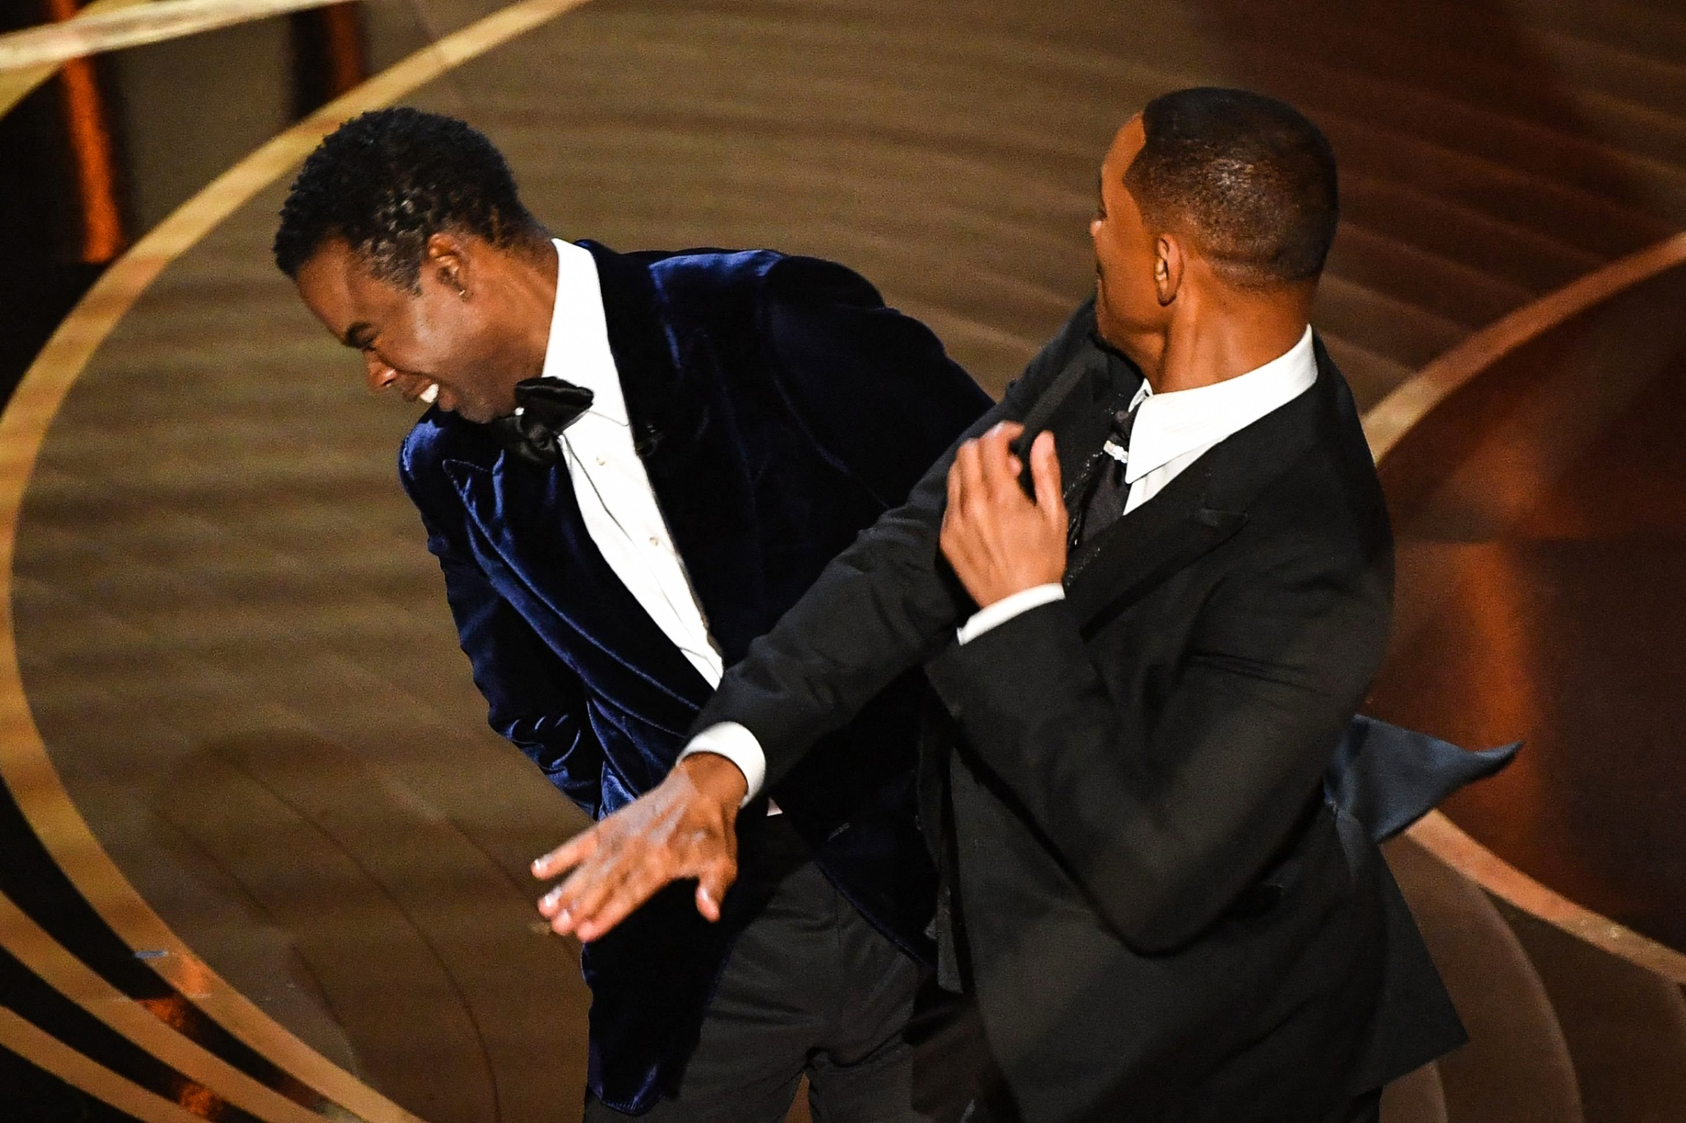
Slapping the rest out of The Office
Get outta here, Chris Rock, sorry, you pretender algorithms..

Slide 16

End of the voyage through ANN with optimizers
Riashad Hassan
ID: 20320001 Department of CSE Fareast International University
Shahidul Islam
ID: 0722210005101007 Department of CSE Fareast International University
Shabab Affanul Hoque
ID: 0722210005101003 Department of CSE Fareast International University

